Slide 1
The Jukebox
Java Programming Project
By
Shweta Yogiraj Landge

Slide 2
The Jukebox
Jukeboxes were invented even before digital music come into existence and certainly much before streaming music became available.
Jukeboxes were commonly used in restaurants and bars to enable customers to choose what music they want to listen.
Electronics and digital jukeboxes became prevalent from the 70′s and 80′s.
Modern jukeboxes are fully computerized and stream music from internet directly.

Slide 3
Content
Technology Used
Objective
Feature
Table Structure of DBMS
ER Diagram

Slide 4
Technology Used
Java
MySQL
External Libraries – mysql.connector.java
Draw.io – Online tool for database Tables.
online.visual-paradigm.com – Online tool for ER Diagram.

Slide 5
Objective
Working on all the concept, knowledge and skills learned in Java program.
Applying clean coding, standard and guidelines to demonstrate the software engineering competency.
Using Professional skills learned during the program to prepare and present my project to the Stakeholders.

Slide 6
Feature
In this project, I am designing the modern Jukebox which contain songs by various artists and podcasts by celebrity.
The songs in Jukebox are categorized on basis of artist, album name and genre and the Podcasts are categorized on the basis celebrity name and Podcast publish date.
User can search the music based on above category and result will be shown in alphabetical order.

Slide 7
Feature
User can create playlist of song or podcast or combination or both.
User can add song and podcast to created playlist as well as existing playlist.
One user can create multiple playlist and can see the content of playlist.
User can play any song or podcast from playlist.

Slide 8
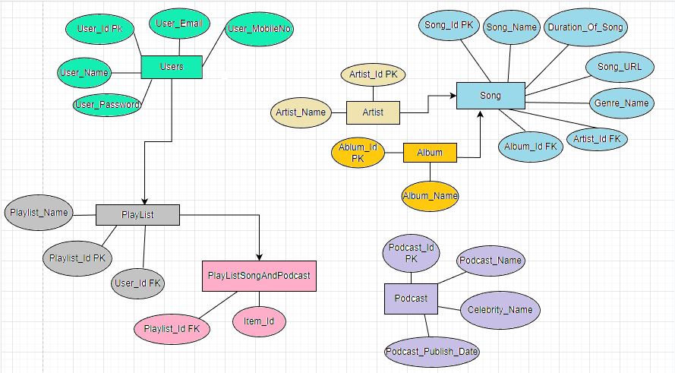
Table structure of DBMS

Slide 9
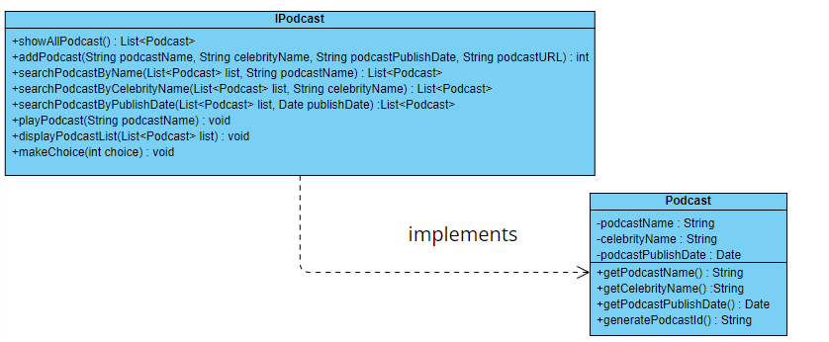
ER Diagram of Class

Slide 10
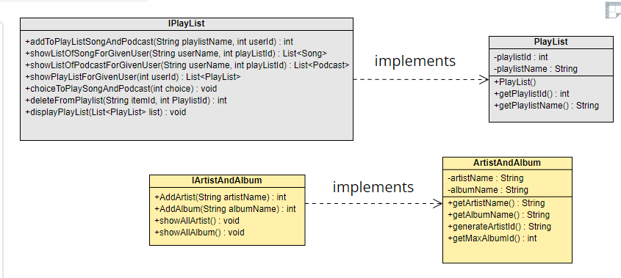

Slide 11
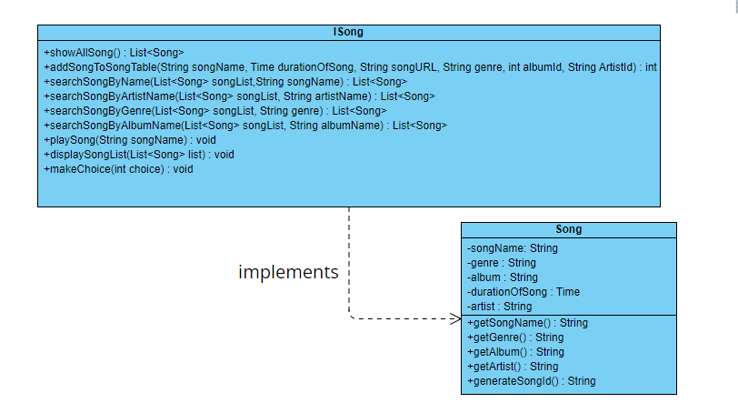

Slide 12
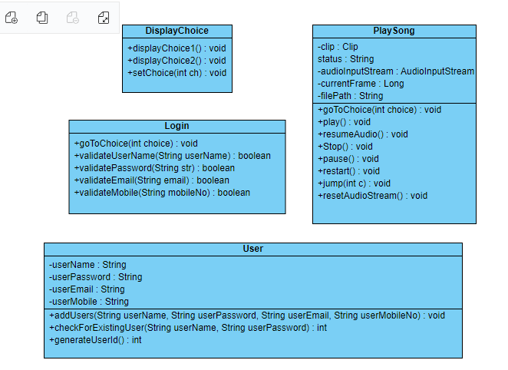

Slide 13
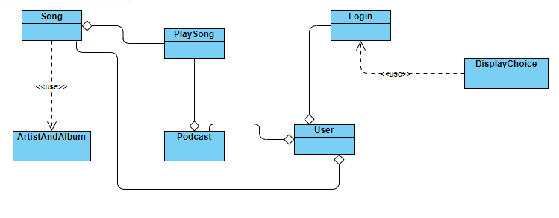

Slide 14
Future Improvements
Can make this application more User friendly.
Can add more features such as play the items in the playlist in queue, shuffle playlist or play next or previous item from list.
Also User can follow the Playlist created by other users and play items from that list.

Slide 15


